Slide 1
COMP-7150 Natural Language Processing Instructor: Salim Sazzed Department of Computer Science University of Memphis

Slide 2
Recap

Slide 3
Morphology is the study of the way words are built from smaller meaningful units called morphemes.
We can divide morphemes into two broad classes:
Stem(s) – the core meaningful units, the root of the word.
Affix(es) – add additional meanings and grammatical functions to words.

Slide 4
A stem is the base or root form of a word to which affixes (prefixes, suffixes, or infixes) are added to derive different forms of the word.
The process of reducing a word to its base or root form is called stemming.
Here's a simple example to illustrate stemming:
Original words: "running," "runner," "ran"
Stemmed form: "run"

Slide 5
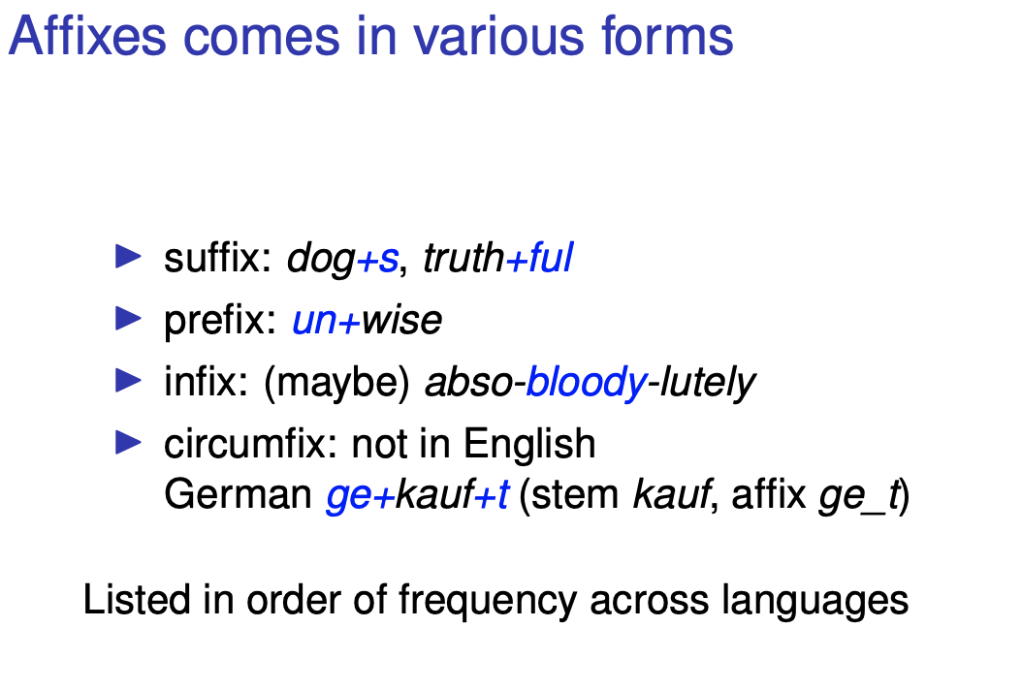

Slide 6
Compounding
Compounding involves combining two or more words to create a new word with a distinct meaning.
The resulting compound often carries a meaning that is related to the individual words.
Compounding is a kind of morphological process because it deals with the internal structure of words and how morphemes (the smallest units of meaning) combine to create new lexical items.

Slide 7
Noun-Noun Compounds
Combining two nouns to create a new noun. For example, "bookshelf" is a compound formed by combining "book" and "shelf.
More examples:
Doghouse: A small shelter or house for a dog.
Sunglasses: Glasses with tinted or darkened lenses to protect the eyes from the sun.
Raincoat: A coat worn to protect against rain.
Airplane: A powered flying vehicle with fixed wings and a weight greater than that of the air it displaces.

Slide 8
Adjective-Noun Compounds
Compounds can also be formed by combining adjectives and nouns.
Create adjective-noun compounds:
Warm coat
Cold water
Hot coffee
Healthy diet

Slide 9
Verb-Noun Compounds:
Combining verbs and nouns can result in compounds that convey specific actions or concepts. For example, "breakfast" is a compound formed by combining the verb "break" and the noun "fast.”
Other examples:
Sleepwalk
Waterfall
Handshake

Slide 10
Reduplication
A linguistic process that involves the repetition of all or part of a word to convey meaning.
This phenomenon is found in many languages.
Reduplication often involves repeating a whole word or a portion of it, such as a morpheme.

Slide 11
Reduplication
Full Reduplication: The entire word is repeated. For example, in Tagalog, "sama" (bad) becomes "sama-sama" (very bad).
Reduplication can serve grammatical functions, such as indicating plurals, intensifying meaning, or forming different verb aspects.
In some languages, reduplication is used for creating diminutives or augmentatives.

Slide 12
In English
While English doesn't extensively use reduplication in the same systematic way as some other languages, it does have instances of reduplication, often for expressive or playful purposes.
Reduplication:
"bye-bye"
"choo-choo" (mimicking the sound of a train)
"night-night" (used to say goodnight)
Reduplication (based on sound):
"walkie-talkie"
"hoity-toity"

Slide 13
Semantic Analysis
Focus: Semantic analysis is concerned with the meaning of words, phrases, and sentences. It aims to understand the intended meaning and context of the language.

Slide 14
Lexical Semantics
A branch of linguistics that focuses on the study of meaning in individual words and how they combine to form meaningful sentences.
Examines the meaning of words in context, considering factors such as word sense, connotation, ambiguity, and the way words contribute to the overall meaning of a sentence or discourse.

Slide 15
Lexical Semantics explores questions related to word meaning, including homonymy (words with different meanings but the same form), synonymy (words with similar meanings), antonymy (words with opposite meanings), and other semantic relationships between words.
Plays a crucial role in understanding how language conveys meaning through the use of words and how speakers interpret and produce meaningful expressions.

Slide 16
Polysemy (multiple meaning)
Polysemy refers to the phenomenon where a single word has multiple meanings that are related in some way.
The word "bank" can have several meanings:
Financial Institution: "I need to go to the bank to withdraw some money."
Sloping Land beside a Body of Water: "They had a picnic by the river bank."
The Side of a Pool or Billiards Table: ”The ball bounced off the cushion and hit the bank."
Polysemy is a common linguistic phenomenon, and it adds richness and flexibility to language use.

Slide 17
Word Sense
Examining the different senses or meanings that a word can have.
Consider the word "bank." Depending on the context, it could refer to:
A financial institution (e.g., "I deposited money in the bank.")
The side of a river (e.g., "They sat by the river bank.")
The act of tilting or inclining (e.g., "The plane began to bank to the left.")

Slide 18
Word Sense Disambiguation (WSD)
Word Sense Disambiguation (WSD) is a natural language processing task that involves determining the correct meaning or sense of a word in a given context.
Many words in natural language have multiple meanings, and WSD aims to identify the most appropriate sense of a word based on the context in which it is used.
Crucial for various language processing applications, including machine translation, information retrieval, and sentiment analysis.

Slide 19
How WSD works?
Methods/techniques for Word Sense Disambiguation may involve using context clues, analyzing syntactic and semantic relationships within a sentence, and leveraging knowledge from lexical databases or machine learning algorithms trained on large corpora.
Successful WSD is essential for improving the accuracy of various natural language processing applications by ensuring that the intended meaning of words is correctly understood in context.

Slide 20
Homonymy
Homonymy refers to the linguistic phenomenon where two or more words have the same form (spelling or pronunciation) but different meanings.
These words may be unrelated in terms of their meaning and may belong to different word classes (e.g., nouns, verbs, adjectives).
There are two main types of homonyms: homophones and homographs.

Slide 21
Homophones:
These are words that have the same pronunciation but different meanings and often different spellings. Examples include:
"bare" (without covering) and "bear" (the animal)
"flower" (a bloom) and "flour" (used in baking)

Slide 22
Homographs:
These are words that have the same spelling but different meanings, and they may or may not have the same pronunciation.
Examples include:
"bat" (the flying mammal) and "bat" (used in sports)
"lead" (to guide) and "lead" (a metal)

Slide 23
Semantic relations
Semantic relations refer to the relationships or connections between words, especially in terms of meaning.
These relations help establish how words are related to one another within a language.
Understanding semantic relations is crucial in various linguistic and computational linguistic tasks.

Slide 24
Synonymy: Words that have similar meanings. For example, "happy" and "joyful" are synonyms
Antonymy: Words that have opposite meanings. Examples include "hot" and "cold," or "happy" and "sad."
Hyponymy/Hypernymy:
Hyponymy: A hyponym is a more specific term within a broader category.
Hypernymy: A hypernym is a more general term that encompasses several more specific terms.
Example: In the relationship "rose" (hyponym) is a type of "flower" (hypernym).

Slide 25
Meronymy and Holonymy:
Meronymy: A meronym is a part that makes up a whole.
Holonymy: A holonym is the whole that includes parts.
Example: In the relationship "finger" (meronym) is a part of the "hand" (holonym).
Troponymy:
Words that describe a specific manner or way in which an action is performed.
Share a general meaning but differ in the manner, intensity, or specific way in which the action is carried out.
Example: "run" and "walk" are troponyms of the more general term "move."

Slide 26
Polysemy: A single word having multiple related meanings. For instance, the word "bank" can refer to a financial institution or the side of a river.
Homonymy: Two or more words have the same form (spelling or pronunciation) but different meanings.
Connotation: The emotional or cultural association attached to a word beyond its literal definition. For example, "snake" may have negative connotations.

Slide 27
Sentence semantics
Sentential semantics, as well as phrasal semantics, deals with the meaning of syntactic units larger than words, i.e. phrases, clauses, and sentences, and the semantic relationships between them.

Slide 28
Some key aspects of sentence semantics
Compositionality
2. Syntactic Structure
3. Tense
4. Negation
5. Semantic roles

Slide 29
Compositionality
Sentence meaning is often compositional, meaning that the meaning of a sentence can be derived from the meanings of its individual components (words and phrases) and their syntactic arrangement.
Sentence: "The cat is out of the bag."
Non-Compositional Interpretation: If interpreted word by word, one might think the cat is physically out of a bag. However, the phrase "out of the bag" is an idiom meaning a secret has been revealed.
Compositional Interpretation: Understanding the meaning of the entire sentence requires recognizing the idiom "out of the bag." It's not about a literal cat and bag, but rather revealing a hidden secret.

Slide 30
Syntactic Structure
Mary helped John wash the dishes."
- This sentence follows a straightforward syntactic structure where "Mary" is the subject, "helped" is the verb, and "John wash the dishes" is the direct object. The action of washing the dishes involves both Mary and John.
The syntactic structure of a sentence, including its grammatical organization and word order, plays a crucial role in determining the overall meaning.
Different Syntactic Structures, Different Meanings:
"Mary helped John wash the dishes."
"Mary helped John, who washed the dishes."
"Mary helped John, who washed the dishes.
"This sentence introduces a relative clause, "who washed the dishes," providing additional information about John. In this case, "Mary" is still the subject, "helped" is the verb, and "John" is the direct object. However, the relative clause specifies that John is the one who washed the dishes.

Slide 31
Tense
Definition: Tense is a grammatical category that expresses the time at which an action or state takes place (e.g., past, present, future).
Example:
Past Tense: "She worked hard yesterday."
Present Tense: "She works hard every day."
Future Tense: "She will work hard tomorrow."

Slide 32
Negation
Sentences:
"I don't like every movie."
"I like every movie."
"I don't like every movie," the negation "don't" applies to the verb "like," and the scope of negation includes the entire statement.
The contrast between "I don't like every movie" and "I like every movie" effectively demonstrates how the presence or absence of negation influence the meaning of the sentences.

Slide 33
Semantic Roles
Sentence semantics involves identifying the semantic roles played by different elements, such as subjects, objects, and modifiers, in relation to the action or state described.
In the first sentence, "John ate the pizza," the semantic roles are clear: "John" is the agent (the one performing the action of eating), and "the pizza" is the patient (the entity undergoing the action).
In the second sentence, "The pizza ate John," the semantic roles are switched, resulting in a different and less plausible meaning. Here, "the pizza" is now cast as the agent, which is not semantically accurate in the context of eating.
Sentences:
"John ate the pizza."
"The pizza ate John."

Slide 34
Why important?
Understanding sentence semantics is crucial for natural language processing tasks such as machine translation, question answering, and sentiment analysis.
It requires considering the interplay of various linguistic elements to extract the intended meaning and nuances conveyed by a sentence.

